Slide 1
ITS 110
Lab Submission Instructions

Slide 2
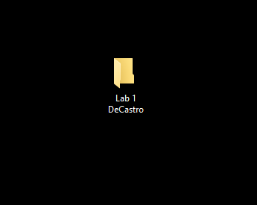
Create a Folder for the Lab that you are submitting with the Lab number and your Last Name.
We are going to use Lab 1 as an example.

Slide 3
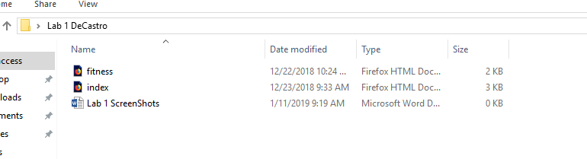
Copy the required files as instructed by the Lab Assignment into that Folder.
In this example, Lab 1 requires the fitness.html, index.html and the Word document with screenshots showing that your page loaded correctly.

Slide 4
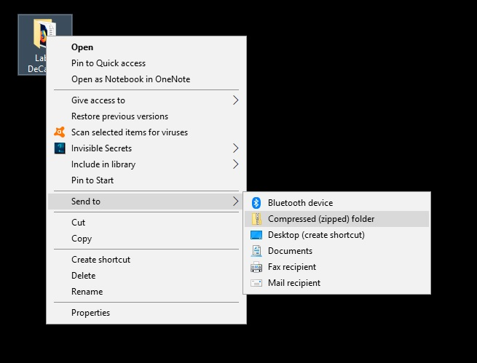
After the required files are copied into the Folder, Right-Click and that Folder.
Select “Send to”
And then Click “Compressed folder”

Slide 5
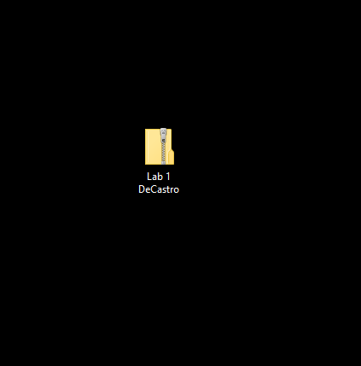
If you followed the instructions correctly, you should see a Folder just like the one above with a Zipper on it.
This is the Folder that should be submitted as your Lab assignment via Blackboard.
DO NOT submit any assignments to me directly. All Assignments (Homework / Lab) should be submitted via Blackboard.

